Slide 1
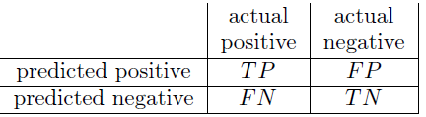
Confusion Matrix
Your positive and negative are classes here. These could also be ‘cat’ or ‘dog’, or maybe ‘dead’ or ‘alive’ (as in Titanic Dataset).
TP – True Positive: # predicted positive that are actually positive
FP – False Positive: # predicted positive that are actually negative
FN – False Negative: # predictions that are actually positive but are predicted negative.
TN – True Negative: # predictions that are actually negative and that are also predicted negative.

Slide 2
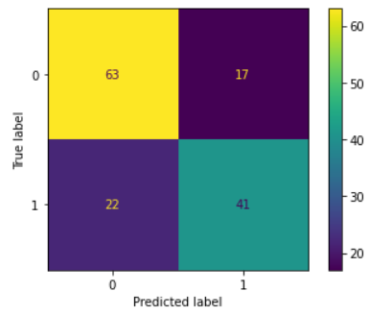
This is the confusion matrix for Decision Tree model’s predictions on the Titanic dataset.
Here, 0: dead and
1: alive

Slide 3
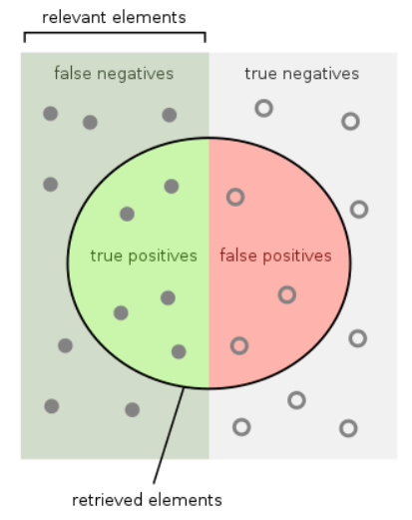
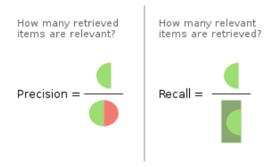
For the ‘positive’ class, calculating precision and recall:
Recall for the dead people (Class: 0):
How many of the people who died are predicted to die by the model based on their features?

Slide 4
Calculating Precision For Positive Class
How many retrieved items are relevant?
Retrieved items -> Predicted positive -> TP + FP
Relevant items -> TP
Precision = TP / (TP + FP)

Slide 5
Calculating Recall For Positive Class
How many relevant items are retrieved?
Relevant items -> Actually positive -> TP + FN
Relevant items -> TP
Recall = TP / (TP + FN)

Slide 6
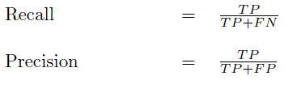


Measuring Classification
Recall = #(relevant docs retrieved) / #(relevant docs)
Precision = #(relevant docs retrieved) / #(retrieved docs)
Suppose a computer program for recognizing dogs in scenes from a video identifies 7 dogs in a scene containing 9 dogs and some cats. If 4 of the identifications are correct, but 3 are actually cats, the program's precision is ? while its recall is ?
When a search engine returns 30 pages only 20 of which were relevant while failing to return 40 additional relevant pages, its precision is ? while its recall is ?

Slide 7
Suppose a computer program for recognizing dogs in scenes from a video identifies 7 dogs in a scene containing 9 dogs and some cats. If 4 of the identifications are correct, but 3 are actually cats, the program's precision is ? while its recall is ?
Solution:
True Positive: 4
False Positive: Predicted dog but was actually cat: 3
“...but 3 are actually cats...”
False Negative: Predicted cat but were actually dogs == How many dogs were predicted as cats?
= 9 actual dogs – 4 predicted dogs = 5
Relevant Items: 9
Retrieved Items: 7
Precision: How many retrieved items are relevant?
4 / 7
Recall: How many of the relevant items are retrieved?
4 / 9

Slide 8
When a search engine returns 30 pages only 20 of which were relevant while failing to return 40 additional relevant pages, its precision is ? while its recall is ?
Solution:
True Positive: 20
Retrieved items: 30
Relevant items: 20 + 40
Precision: 20 / 30 = 2/3
Recall: 20 / 60 = 1/3

Slide 9
Measuring Classification
Recall = #(relevant docs retrieved) / #(relevant docs)
Precision = #(relevant docs retrieved) / #(retrieved docs)
Suppose a computer program for recognizing dogs in scenes from a video identifies 7 dogs in a scene containing 9 dogs and some cats. If 4 of the identifications are correct, but 3 are actually cats, the program's precision is 4/7 while its recall is 4/9.
When a search engine returns 30 pages only 20 of which were relevant while failing to return 40 additional relevant pages, its precision is 20/30 = 2/3 while its recall is 20/60 = 1/3

Slide 10
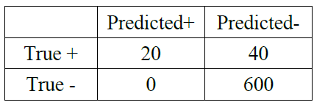




Measuring Classification

Slide 11


Micro average precision
The micro average precision is the sum of all true positives divided by the sum of all true positives and false positives. In other words, we divide the number of correctly identified predictions by the total number of predictions. The micro average calculation of the data above would be as follows:
Precision = TP / (TP + FP)
Macro average precision
The macro average precision is the arithmetic mean of all the precision values for the different classes. The macro average calculation of the data above would be as follows:

Slide 12
For Titanic dataset: You have two classes: Dead and alive.
Recall formula is: TP / (TP + FN)
The reason for averaging across the classes is because:
Who identifies which one is a positive class?
Recall using microaveraging:
TP_dead + TP_alive / (TP_dead + TP_alive + FN_dead + FN_alive)
Recall using macroaveraging:
Recall_dead + Recall_alive / 2

Slide 13
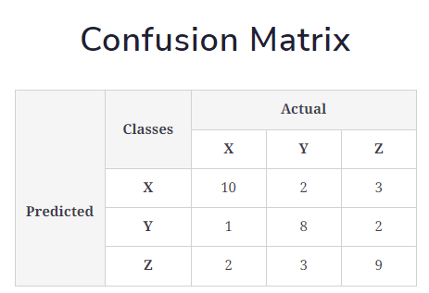

Slide 14
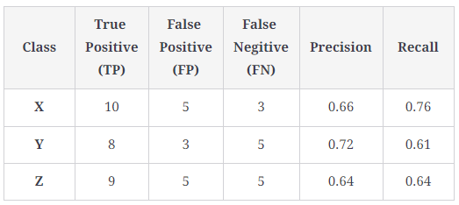
Precision = TP / (TP + FP)
How many of the retrieved items are relevant?
Recall = TP / (TP + FN)
How many of the relevant items are retrieved?

Slide 15
Average takes into account the precision for all the classes.
It you talk about the Precision formula of: TP / (TP + FP)
This is specific to the class you are referring to as ‘Positive’.

Slide 16
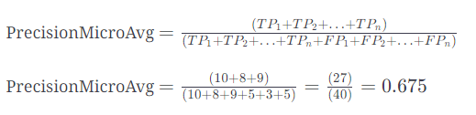
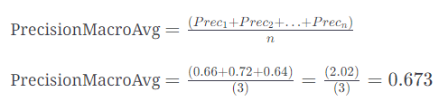
Micro average precision
Macro average precision

Slide 17
F1 Score
You are working on credit card transaction data.
Your task is to identify a fraudulent transaction.
Fraudulent transactions happen in a very small fraction like 0.1%. That’s like one in thousand, which is also very high taken for demonstration.
In general:
False Positive would be very high.
What is False Positive?
Predicted fraudulent but are actually genuine transactions.
Precision: How many of the retrieved items are relevant?
This would be very low.
But Recall might be decent.
False Negative: Predicted genuine but are actually fraudulent.

Slide 18
F1 Score (continued)
In such a usecase where Precision is very low and Recall is decent/okay for first attempt of model building, and on trying to improve Precision, it lowers the recall:
Here we need a better metric than Precision and Recall to measure the performance of the model.
This metric is the harmonic mean of Precision and Recall named as ‘F1 Score’.
F1 Score would be high only if both precision and recall are high.
F1 Score would be low if either of precision or recall is low.

